Slide 2
We proclaim how great you are and tell of the wonderful things you have done.
Psalm 75:1

Slide 3
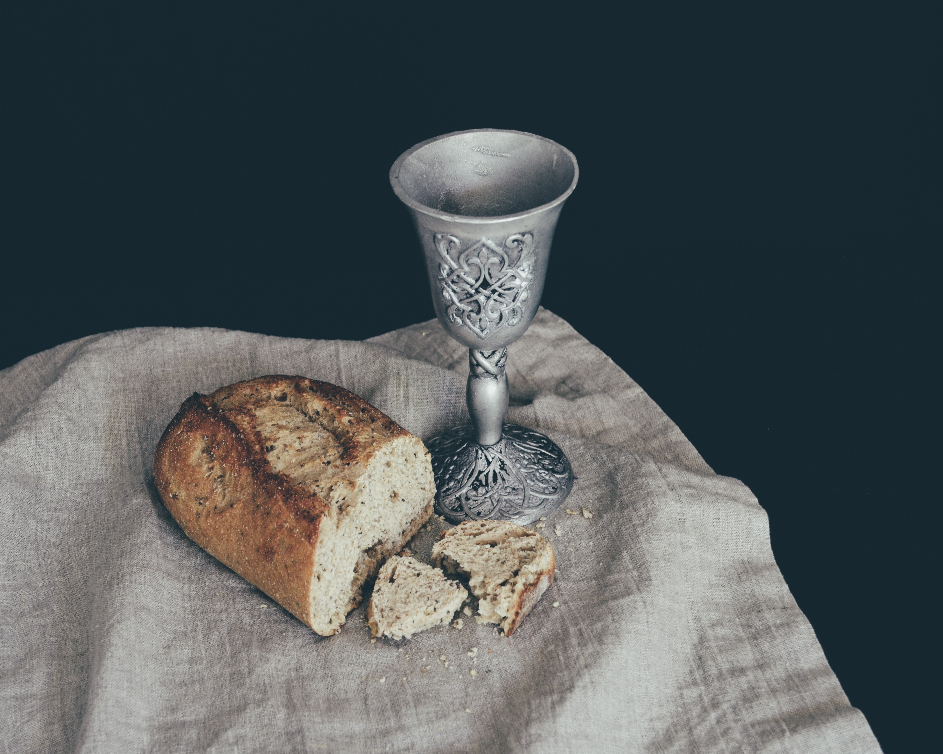

Slide 4
And he took bread, gave thanks and broke it, and gave it to them, saying, “This is my body given for you; do this in remembrance of me.” In the same way, after the supper he took the cup, saying, “This cup is the new covenant in my blood, which is poured out for you.
Luke 22:19-20

Slide 6
Honor the Lord with your wealth, with the first fruits of all your crops; then your barns will be filled to overflowing, and your vats will brim over with new wine
Proverbs 3:9-1

Slide 9
INSERT VIDEO

Slide 11
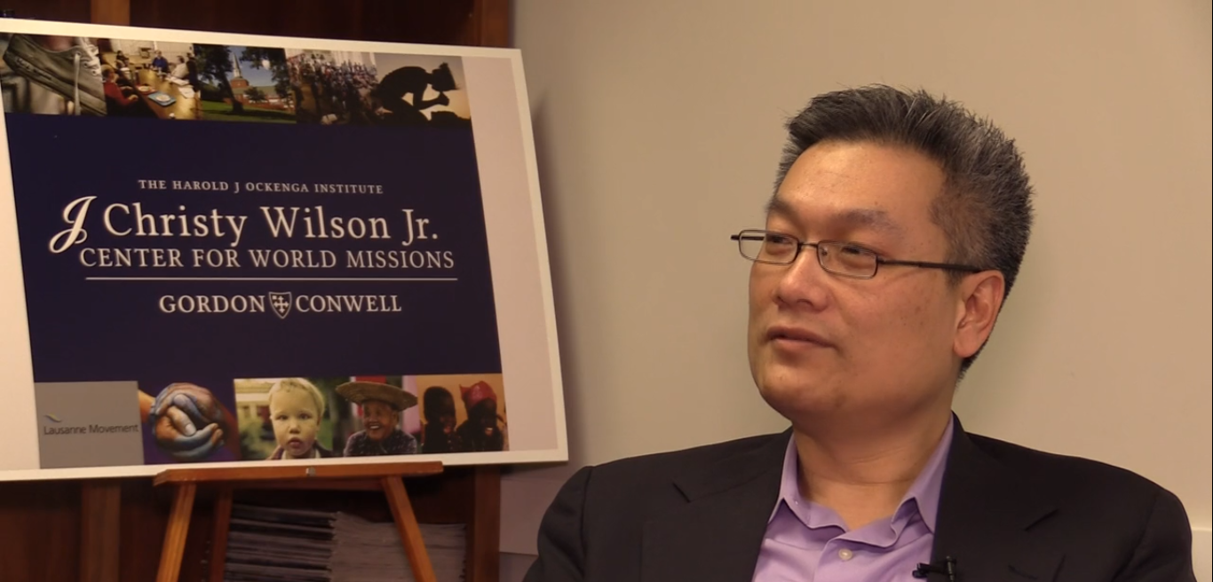
NEXT WEEK
SPECIAL GUEST SPEAKER
DAVID RO & JACKIE RO

Slide 14
I like my water like I like my emotions.
BOTTLED

Slide 15
Therapist: Did you know that you have an inability to verbally express your emotions?
Me: Can’t say that I’m surprised.

Slide 16
Why don’t men often show their true feelings?
Because they don't have any.

Slide 21
HOPE DEFINED
Worldly hope → wish, want, “maybe”
Biblical hope → that which is absolutely certain, definite and true about a future event

Slide 22
HOPE MATTERS
“The opposite of joy isn’t sorrow, it’s hopelessness.”
– Tim Keller

Slide 23
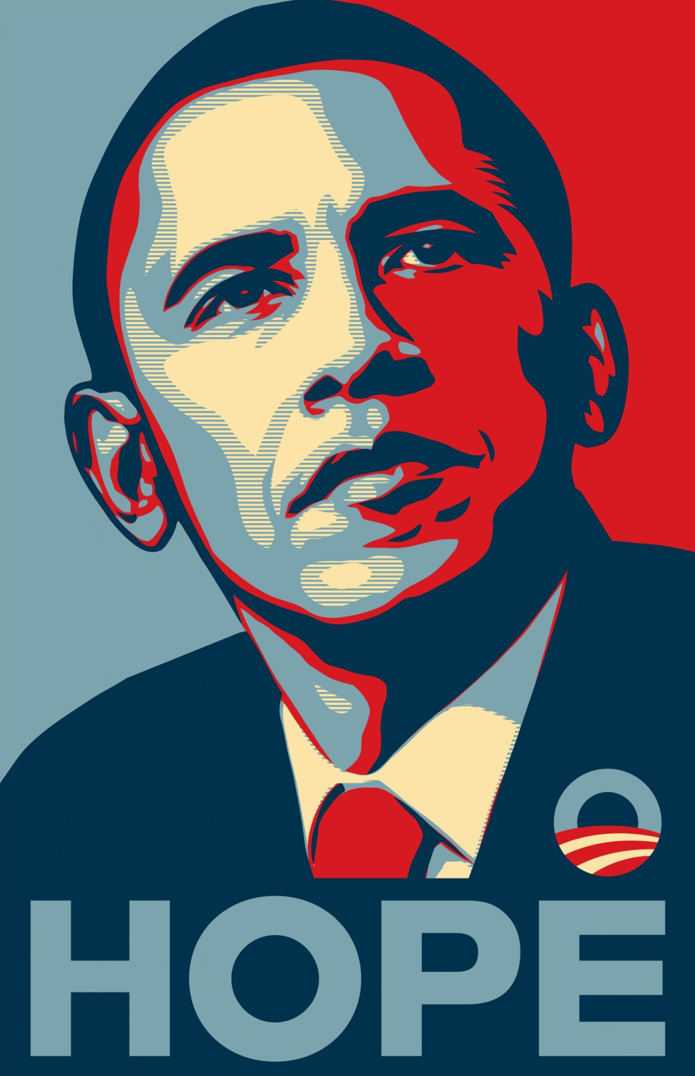

Slide 24
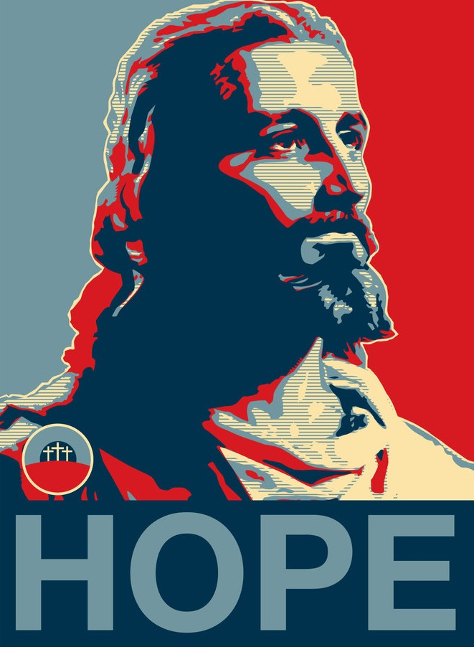
HOPE

Slide 25
Therefore, having been justified by faith, we have peace with God through our Lord Jesus Christ,
ROMANS 5:1 (NASB)

Slide 26
through whom also we have obtained our introduction by faith into this grace in which we stand; and we exult in hope of the glory of God.
ROMANS 5:2 (NASB)

Slide 27
And not only this, but we also exult in our tribulations, knowing that tribulation brings about perseverance; and perseverance, proven character; and proven character, hope;
ROMANS 5:3-4 (NASB)

Slide 28
and hope does not disappoint, because the love of God has been poured out within our hearts through the Holy Spirit who was given to us.
ROMANS 5:5 (NASB)

Slide 29
Now faith is the assurance of things hoped for, the conviction of things not seen.
HEBREWS 11:1 (NASB)

Slide 30
350 MILLION PEOPLE:
Number of people worldwide
suffer depression
16.2 MILLION PEOPLE:
Number of adults in the United States (6.7% of all adults) have experienced a major depressive episode in the past year
That’s 3.4% of the world’s population
15% is estimated of the adult population will experience depression in their lifetime

Slide 31
WHY DO WE CARE
IF SOMEONE IS SUFFERING
FROM DEPRESSION?
!
OVER 800,000 PEOPLE
Commit suicide every year due
to their depression.

Slide 33
WHY ARE PEOPLE DEPRESSED?
They feel “lost”.
They have no clear goals or desired outcomes in life.

Slide 34
WHY ARE PEOPLE DEPRESSED?
They have no idea what is their purpose, no feeling that anyone cares about them.
They have a chronic addiction to, or dependency on, drugs and/or alcohol.

Slide 35
HOW DOES IT FEEL?
Constantly like under a dark cloud
Sense of sadness, no way to cope with pain

Slide 36
HOW CAN YOU GET OUT?
Trust in God’s Word that your future is bright – things will get better!
You do have a purpose: God has a plan to prosper you and to give you a future and a hope.

Slide 37
HOW CAN YOU GET OUT?
Recognize that your problems will make you stronger. (Romans 8:28)

Slide 38
And we know that in all things God works for the good of those who love him, who have been called according to his purpose.
ROMANS 8:28 (NIV)

Slide 39
HOW CAN YOU GET OUT?
Do something for someone else; get connected to spiritual family.
PUT YOUR HOPE IN GOD! (Psalm 42)

Slide 40
Why am I discouraged?
Why is my heart so sad?
I will put my hope in God!
I will praise him again—
my Savior and my God!
PSALM 42:11 (NLT)

Slide 41
“WHERE SHOULD WE PUT OUR HOPE IN?”
God’s Word (i.e., His promises)
God’s love
Resurrection, salvation & eternal glory in heaven

Slide 42
Hebrews 6:19 (NIV)
“We have this hope as an anchor for our soul, firm and secure.”

Slide 43
Out of the depths I cry to you, Lord;
Lord, hear my voice.
Let your ears be attentive
to my cry for mercy.
PSALM 130:1-2 (NIV)

Slide 44
If you, Lord, kept a record of sins,
Lord, who could stand?
But with you there is forgiveness,
so that we can, with reverence, serve you.
PSALM 130:3-4 (NIV)

Slide 45
I wait for the Lord, my whole being waits,
and in his word, I put my hope.
I wait for the Lord
more than watchmen wait for the morning,
more than watchmen wait for the morning.
PSALM 130:5-6 (NIV)

Slide 46
Israel, put your hope in the Lord,
for with the Lord is unfailing love
and with him is full redemption.
He himself will redeem Israel
from all their sins.
PSALM 130:7-8 (NIV)

